Slide 1

A Case Study for Large-Scale Vehicle Routing
By:
Aniket Amar Thopte
Brian Joseph
Omkar Omprakash Jadhav
Shivraj Bhandigare

Slide 2
Introduction:
Vehicle routing problem (VRP)
Route planning techniques
Project presents two of the different route planning algorithms
Integer Programming
VRP Spreadsheet Solver
Comparing and analyzing their performance

Slide 3
Aim and Objective:
Aim:
To prepare an internal estimate of annual freight transportation miles (Distance Optimization)
To maintain the current delivery day schedule from a single point Distribution center to all the stores
To develop and optimize transportation model to transport maximum goods for the shortest path available
Objective:
To reduce the total freight distance
To optimize the existing network considering the constraints
To accommodate fixed, repeatable service schedules

Slide 4
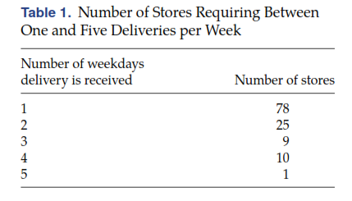
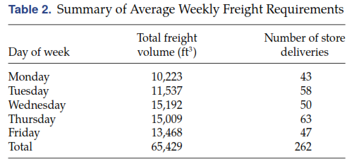
Most important store requirements:

Slide 5
Constraints:
According to the U.S. Department of Transportation.
Following are the constraints:
Delivery timings: 8.00am to 6.00pm.
Stores receive order on the same day as mentioned
Maximum driving time: 10 hours
On duty driver time: 14 hours (includes loading/unloading, idle, driving time)
Vehicle speed: 40 miles/hour
Minimum unload time: 30 mins. or 0.030min./cubic ft. volume (max. value)
Vehicle Capacity: 3200 cubic ft.
Vehicle should arrive at the store at 8.00 am.

Slide 6
Methodology:
The two techniques implemented in this project are:
Vehicle Routing Problem (VRP) Spreadsheet Solver:
Day-wise route optimization in MS-Excel
Utilizes Bing Maps web service to retrieve coordinate and distance data
Uses a Large Neighborhood Search algorithm to provide solutions
VRP Solver:
Is windows based open-source solver for VR problems
Works on Clarke-Wright Algorithm
Uses Randomization and Swapping for better results

Slide 7
Objective
Want to minimize
The total routes for each day
The total distance travelled by each vehicle
To get the required solution in given constraints

Slide 8
What can we do?
Basic VRP
VRP with time window
Multi-depot
Heterogeneous fleet
Open VRP
-- Requires anywhere location
Compatibility
Pickup and Delivery problems
Variable load and unload time
Dispatch time constraint
Introducing fixed cost

Slide 9
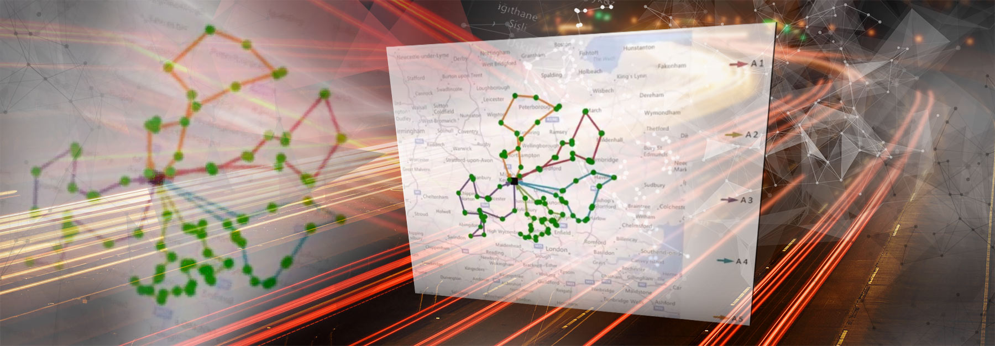
Excel spreadsheet solver for vehicle Routing

Slide 10
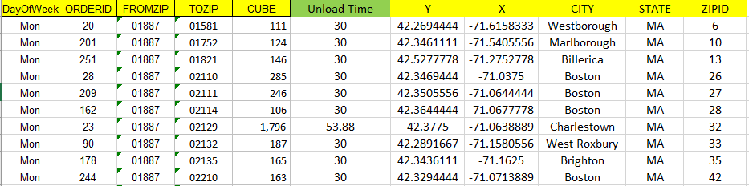
Step 1: Data Segregation, Unload Time Calculation & Distance Matrix

Slide 11
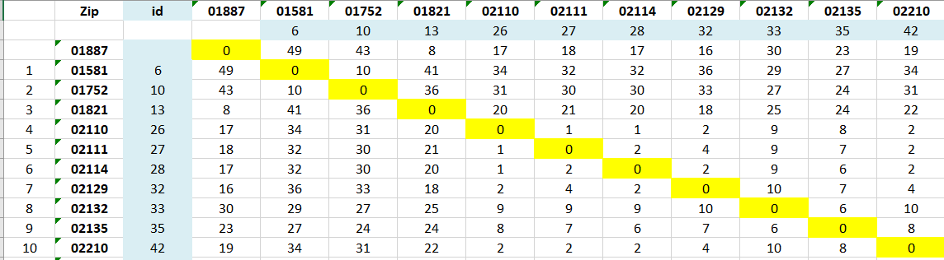
Distance matrix for Monday.

Slide 12
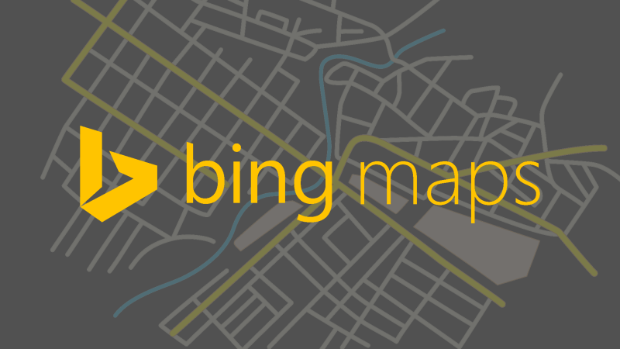
Step 2: Generating Bing map key.

Slide 13
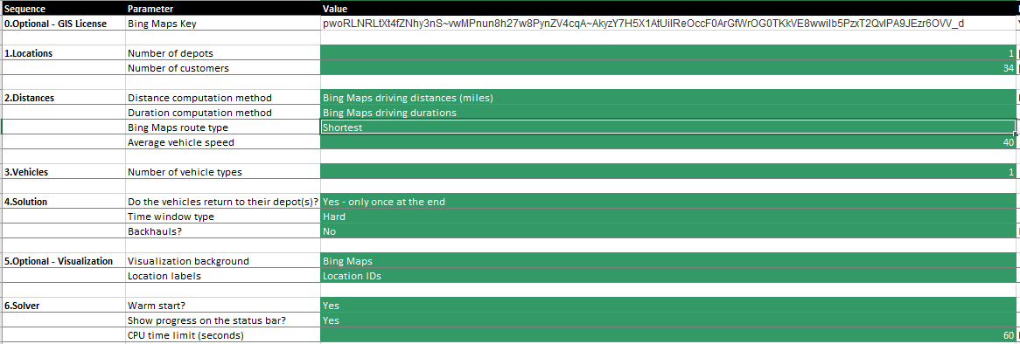
Step 3: Setting up the Excel spreadsheet solver and inputting the constraints based on locations, distances and vehicles details.

Slide 14
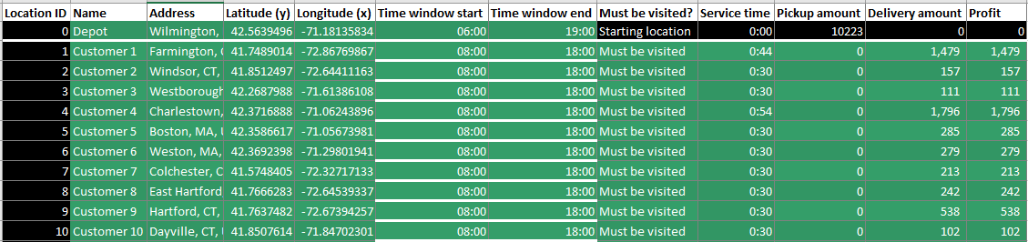
Locations setup.

Slide 15
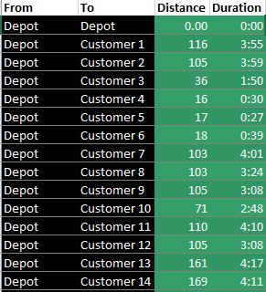
Distance setup.

Slide 16
Vehicle details

Slide 17
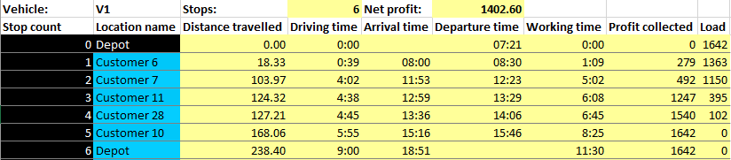
Results

Slide 18
Visualization

Slide 19
LSVR Using VRP Solver.
VRP solver is a Windows-based Solver used for vehicle routing problems.
It builds vehicle routes that visit every customer point exactly once and that obey user-specified limits.
It takes input from data containing listing of each customer's location (latitude and longitude), customer demands, vehicle capacity, node to node distance matrix, etc.

Slide 20
LSVR Using VRP Solver.
Working:
VRP Solver implements an adaptation of the Clarke-Wright savings algorithm for vehicle routing problems.
The Clarke-Wright savings algorithm is a well-known algorithm in vehicle routing and is described in various papers and texts.
The method utilizes techniques like randomization, improvement heuristics.

Slide 21
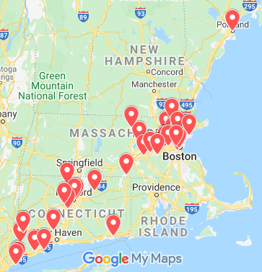
Geographical Locations of Friday Delivery Schedule
Total Number of stores to Deliver: 41
Stores spread across 3 States: MA, ME, CT
Total Cargo Volume to ship: 13468 cubic ft

Slide 22
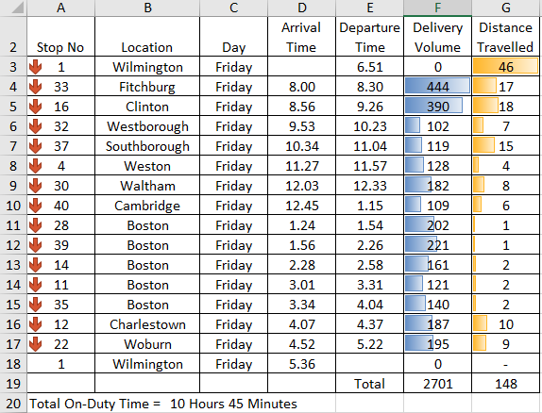
Optimized Route 1 for Friday Delivery Schedule

Slide 23
Deduction for the VRP Solver Method
Using this method we get a total of 6 optimized routes for Friday delivery schedule.
The total transportation miles travelled throughout the day are 1380 miles.
To conclude the solver is easy to use and gives optimized routes using less run-time.

Slide 24
COMPARSION MATRIX
DAYS | No. of Routes |  | Total Distance Traveled |  | Total Cargo Volume
 | Method 1 | Method 2 | Method 1 | Method 2 | Both Methods
MONDAY | 7 | 6 | 1823 | 1787 | 10223
TUESDAY | 5 | 5 | 1518 | 1882 | 11537
WEDNESDAY | 6 | 7 | 882 | 1434 | 15192
THURSDAY | 7 | 7 | 1364 | 1990 | 15009
FRIDAY | 5 | 6 | 1236 | 1380 | 13468

Slide 25
Conclusion
We know how to construct a solution to a VRP by using different methods.
We discussed two different methods for solving vehicle routing problem.
Improve solutions using various tools such as randomization and swapping for better results.
Real problems often have unique constraints which can change the solution to some extent.
We found out how to easily change the model to include new constraints without changing the core solve method.
The number of routes and the total distance travelled found by NHG must be less than or equal to that provided by MAD.

Slide 26
References
http://www.bingmapsportal.com/
Larry Snyder.” Larry Snyder RSS, coral.ise.lehigh.edu/larry/software/vrp-solver/.

